Slide 1
sonarqube

Slide 2
sonarQube
SonarQube is an automatic code review tool to detect bugs, vulnerabilities, and code smells in your code. It can integrate with your existing workflow to enable continuous code inspection across your project branches and pull requests.
SonarQube empowers all developers to write cleaner and safer code.
Enhance Your Workflow with Continuous Code Quality & Code Security

Slide 3
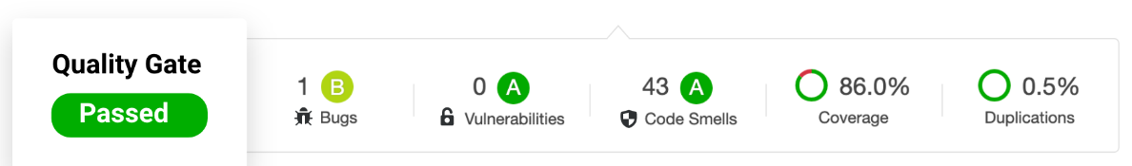
Quality Gate
Release Quality Code Every Time.
Quality Gates tell you at every analysis whether your code is ready to release.

Slide 4
Quality Gates show your project Releasability
Bugs suck
Delivering buggy software erodes your reputation and your users' confidence.

Slide 5
Protect your reputation
Out of the box, SonarQube clearly signals whether your commits are clean, your projects are releasable, and how well your organization is hitting the mark.
Get clear feedback
And if you’re not hitting the mark, you’ll know immediately what’s wrong and how to fix it. Wouldn’t it be nice if all feedback were that clear and direct?

Slide 6
Always know where you stand
Keep quality front and center throughout the development cycle.
Quality Gate Quality Gate Passed
You won’t be surprised at the last minute with quality problems. SonarQube gives you a clear releaseability indicator at every build.
Quality Gate Quality Gate Failed
Quality Gates coalesce the team around a shared vision of quality. Everyone knows the standard and whether it’s being met.

Slide 7
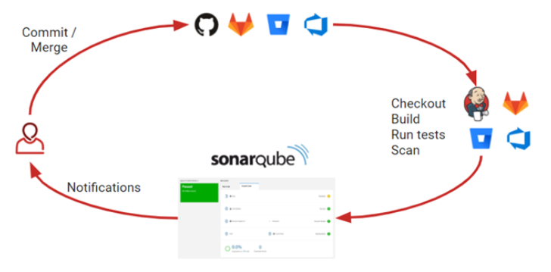
Overview

Slide 8
Installation of sonarQube & integrating with Jenkins

Slide 9
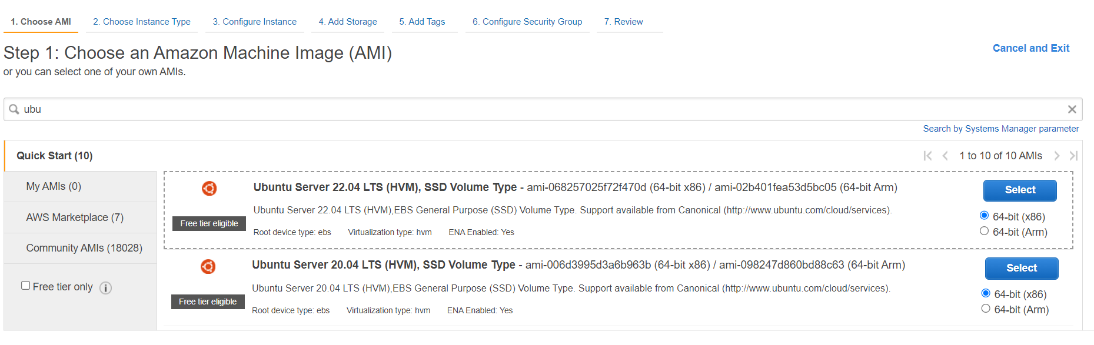
Choose the Ubuntu 22.04 AMI

Slide 10
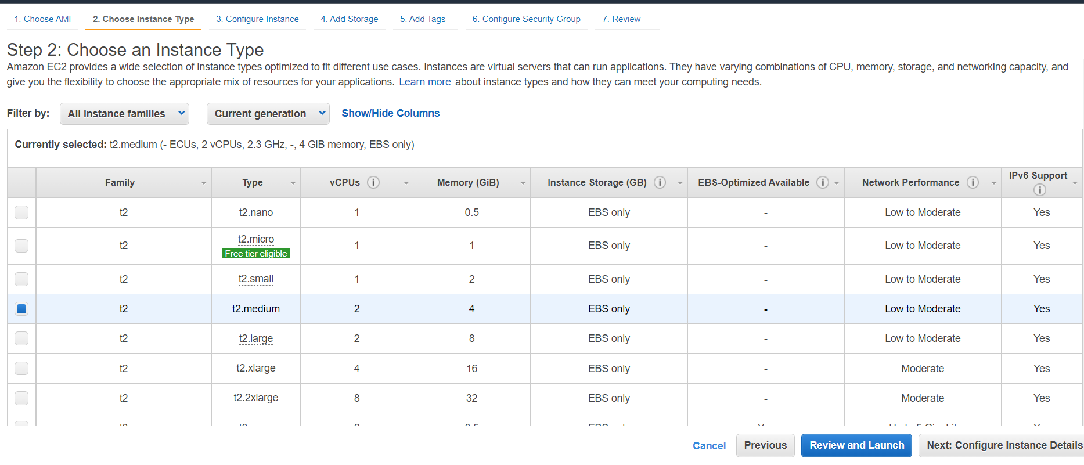
Choose the t2.medium instance.

Slide 11
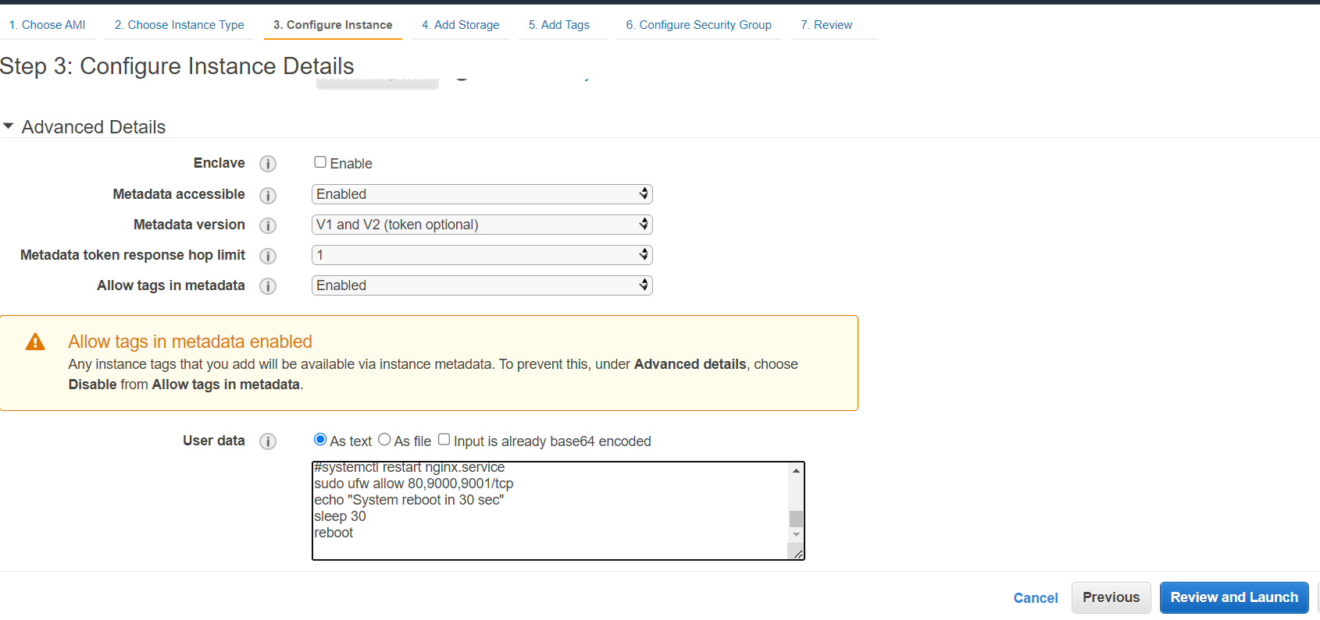
Add the user data for sonarqube or run as a script in terminal

Slide 12
User data for installing sonar-qube
#!/bin/bash
cp /etc/sysctl.conf /root/sysctl.conf_backup
cat <<EOT> /etc/sysctl.conf
vm.max_map_count=262144
fs.file-max=65536
ulimit -n 65536
ulimit -u 4096
EOT
cp /etc/security/limits.conf /root/sec_limit.conf_backup
cat <<EOT> /etc/security/limits.conf
sonarqube - nofile 65536
sonarqube - nproc 409
EOT
sudo apt-get update -y
sudo apt-get install openjdk-11-jdk -y
sudo update-alternatives --config java
java -version
sudo apt update

Slide 13
wget -q https://www.postgresql.org/media/keys/ACCC4CF8.asc -O - | sudo apt-key add -
sudo sh -c 'echo "deb http://apt.postgresql.org/pub/repos/apt/ `lsb_release -cs`-pgdg main" >> /etc/apt/sources.list.d/pgdg.list'
sudo apt install postgresql postgresql-contrib -y
#sudo -u postgres psql -c "SELECT version();"
sudo systemctl enable postgresql.service
sudo systemctl start postgresql.service
sudo echo "postgres:admin123" | chpasswd
runuser -l postgres -c "createuser sonar"
sudo -i -u postgres psql -c "ALTER USER sonar WITH ENCRYPTED PASSWORD 'admin123';"
sudo -i -u postgres psql -c "CREATE DATABASE sonarqube OWNER sonar;"
sudo -i -u postgres psql -c "GRANT ALL PRIVILEGES ON DATABASE sonarqube to sonar;"
systemctl restart postgresql
#systemctl status -l postgresql
netstat -tulpena | grep postgres
sudo mkdir -p /sonarqube/
cd /sonarqube/
sudo curl -O https://binaries.sonarsource.com/Distribution/sonarqube/sonarqube-8.3.0.34182.zip
sudo apt-get install zip -y
sudo unzip -o sonarqube-8.3.0.34182.zip -d /opt/
sudo mv /opt/sonarqube-8.3.0.34182/ /opt/sonarqube

Slide 14
sudo groupadd sonar
sudo useradd -c "SonarQube - User" -d /opt/sonarqube/ -g sonar sonar
sudo chown sonar:sonar /opt/sonarqube/ -R
cp /opt/sonarqube/conf/sonar.properties /root/sonar.properties_backup
cat <<EOT> /opt/sonarqube/conf/sonar.properties
sonar.jdbc.username=sonar
sonar.jdbc.password=admin123
sonar.jdbc.url=jdbc:postgresql://localhost/sonarqube
sonar.web.host=0.0.0.0
sonar.web.port=9000
sonar.web.javaAdditionalOpts=-server
sonar.search.javaOpts=-Xmx512m -Xms512m -XX:+HeapDumpOnOutOfMemoryError
sonar.log.level=INFO
sonar.path.logs=logs
EOT
cat <<EOT> /etc/systemd/system/sonarqube.service
[Unit]
Description=SonarQube service
After=syslog.target network.target
[Service]
Type=forking

Slide 15
ExecStart=/opt/sonarqube/bin/linux-x86-64/sonar.sh start
ExecStop=/opt/sonarqube/bin/linux-x86-64/sonar.sh stop
User=sonar
Group=sonar
Restart=always
LimitNOFILE=65536
LimitNPROC=4096
[Install]
WantedBy=multi-user.target
EOT
systemctl daemon-reload
systemctl enable sonarqube.service
#systemctl start sonarqube.service
#systemctl status -l sonarqube.service
apt-get install nginx -y
rm -rf /etc/nginx/sites-enabled/default
rm -rf /etc/nginx/sites-available/default
cat <<EOT> /etc/nginx/sites-available/sonarqube

Slide 16
server{
listen 80;
server_name sonarqube.groophy.in;
access_log /var/log/nginx/sonar.access.log;
error_log /var/log/nginx/sonar.error.log;
proxy_buffers 16 64k;
proxy_buffer_size 128k;
location / {
proxy_pass http://127.0.0.1:9000;
proxy_next_upstream error timeout invalid_header http_500 http_502 http_503 http_504;
proxy_redirect off;
proxy_set_header Host \$host;
proxy_set_header X-Real-IP \$remote_addr;
proxy_set_header X-Forwarded-For \$proxy_add_x_forwarded_for;
proxy_set_header X-Forwarded-Proto http;
} }
EOT
ln -s /etc/nginx/sites-available/sonarqube /etc/nginx/sites-enabled/sonarqube
systemctl enable nginx.service
#systemctl restart nginx.service
sudo ufw allow 80,9000,9001/tcp
echo "System reboot in 30 sec"
sleep 30
reboot

Slide 17
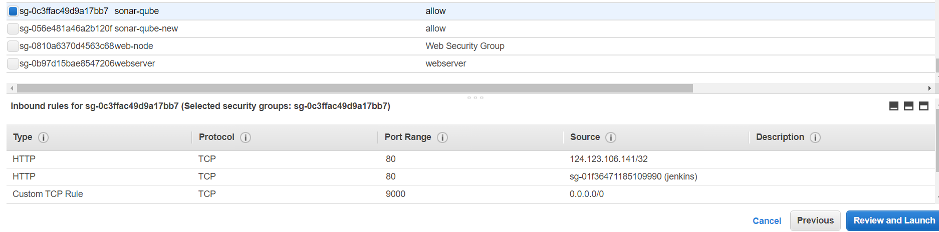
Allow the custom TCP 9000 port

Slide 18
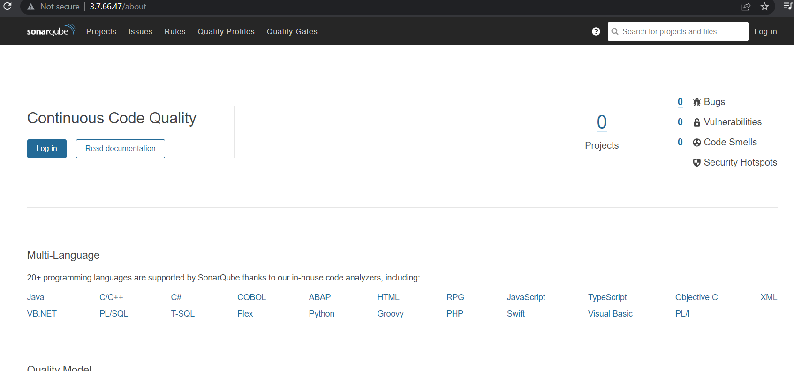
Copy the sonarqube instance IP with port in browser <IP:9000>
Click on login

Slide 19
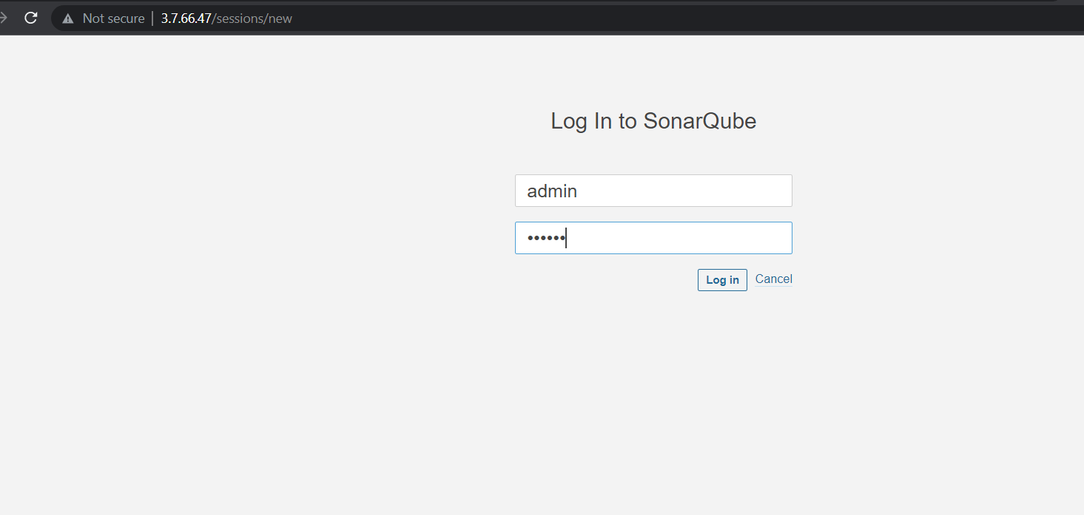
Add the
user name: admin
Passwd: admin

Slide 20
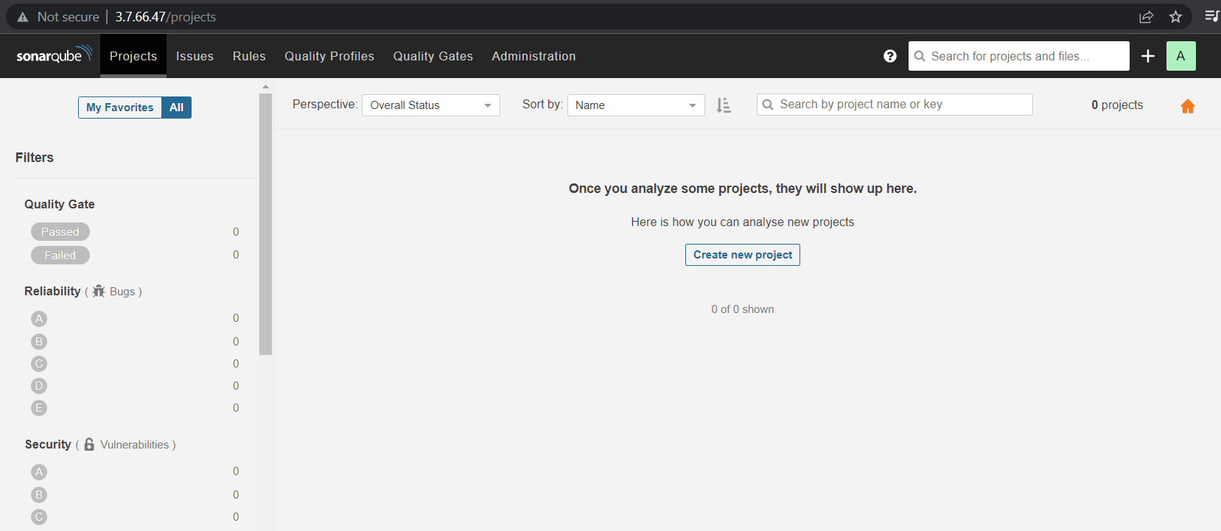
Click on create new project .

Slide 21
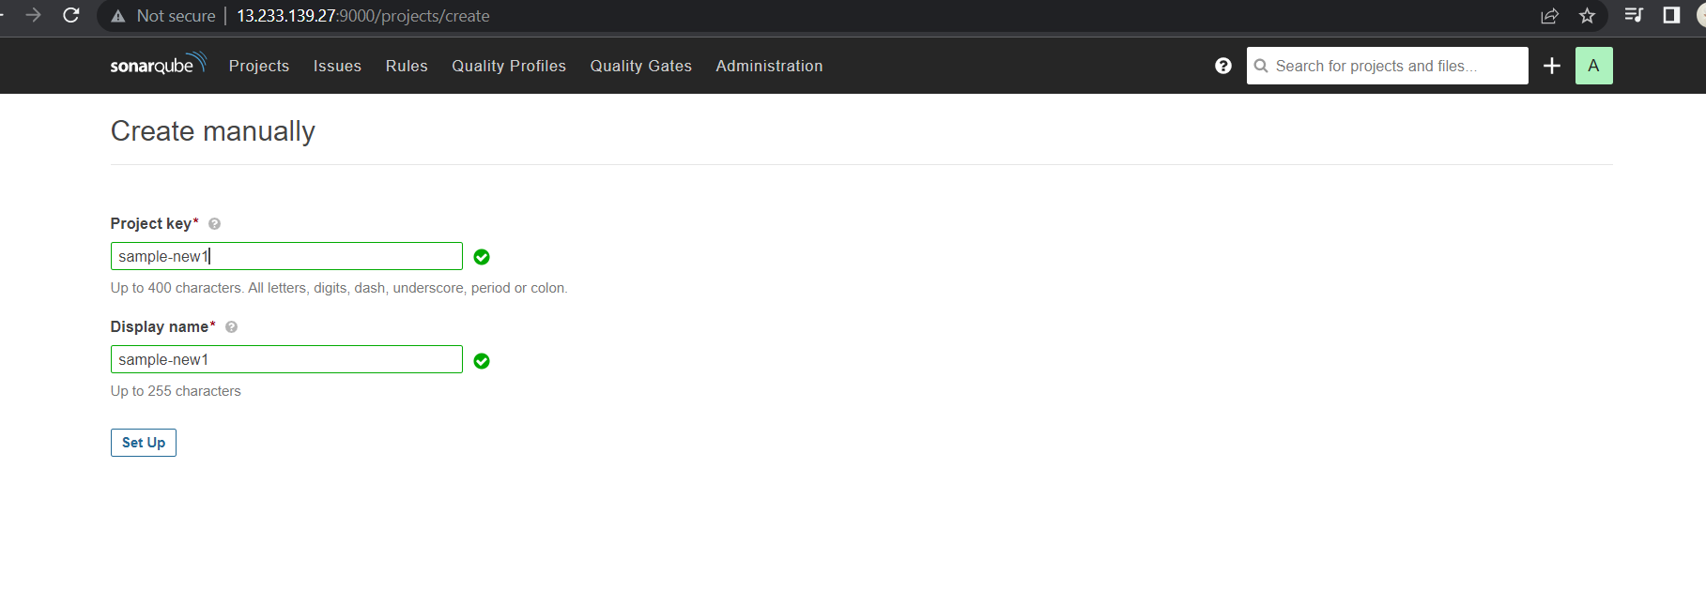
Give the project-key(project name).

Slide 22
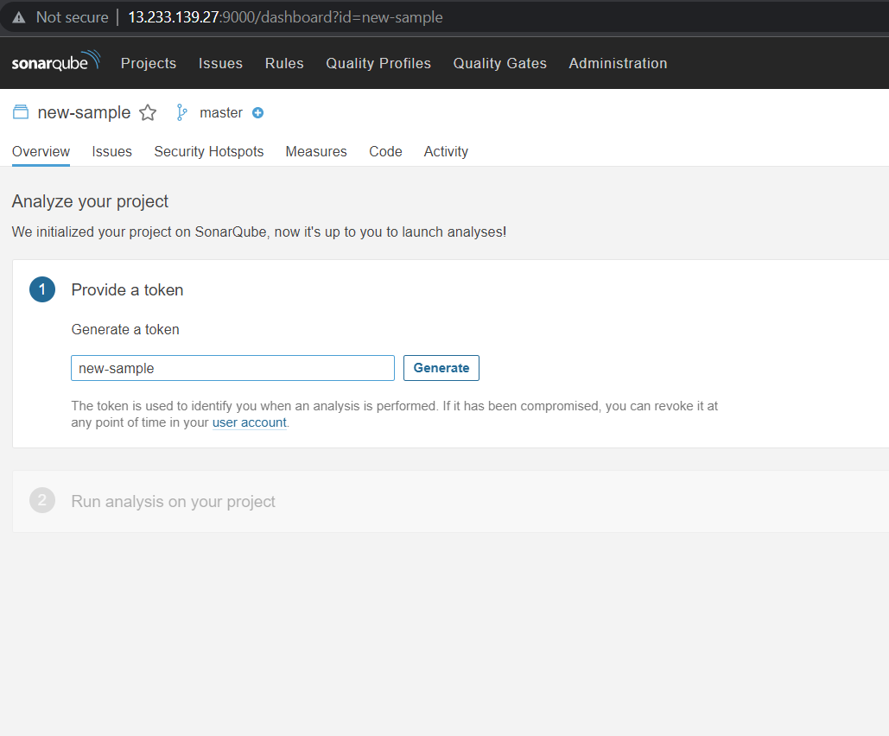
Give a name for token & click on generate.

Slide 23
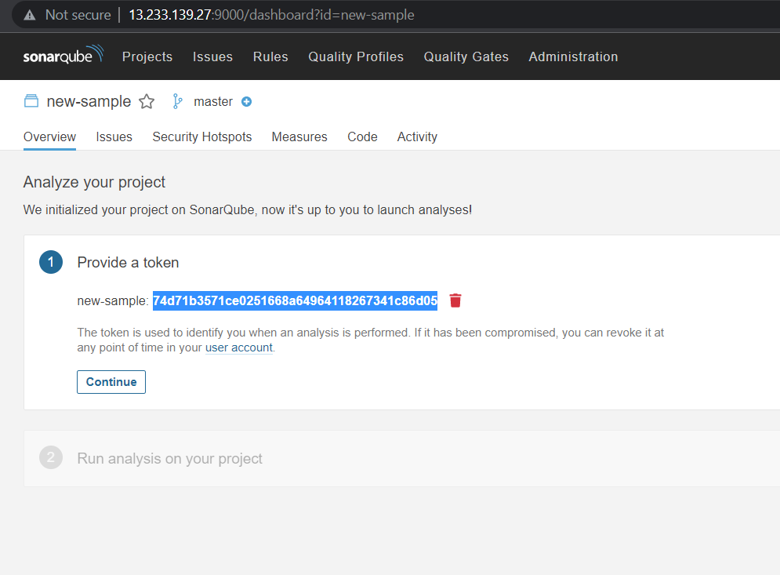
Copy the token & paste it for future reference.

Slide 24
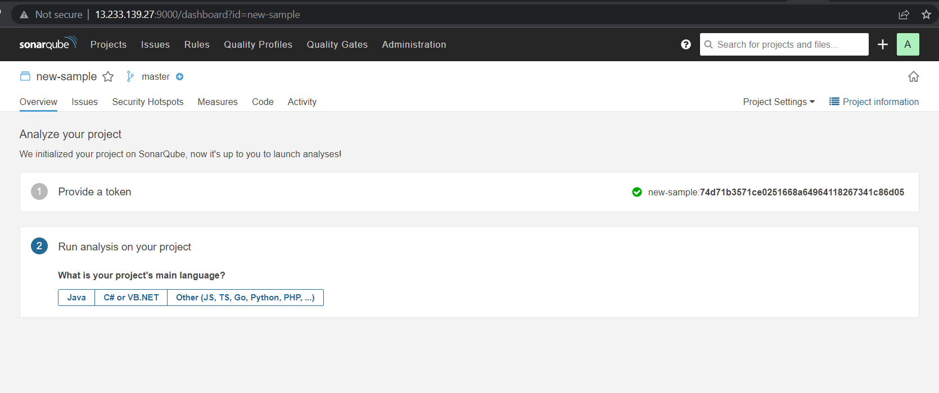
Choose the script in which language we are going to write the code.

Slide 25
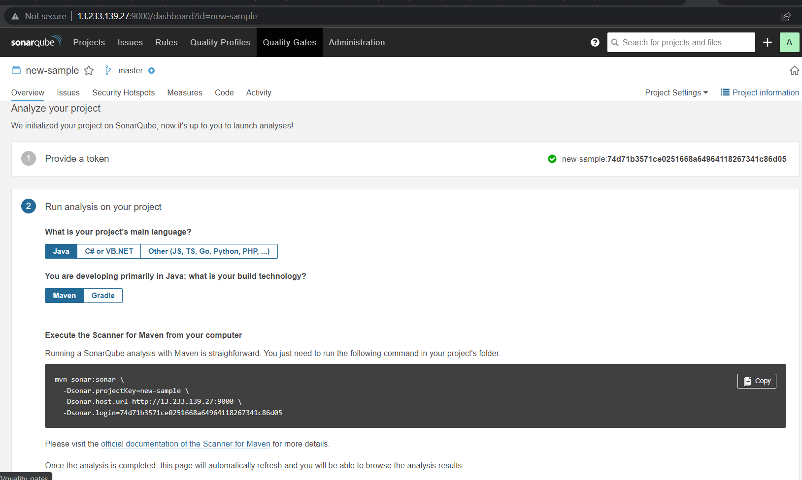
Choose the build tool which we are going to use in software development.

Slide 26
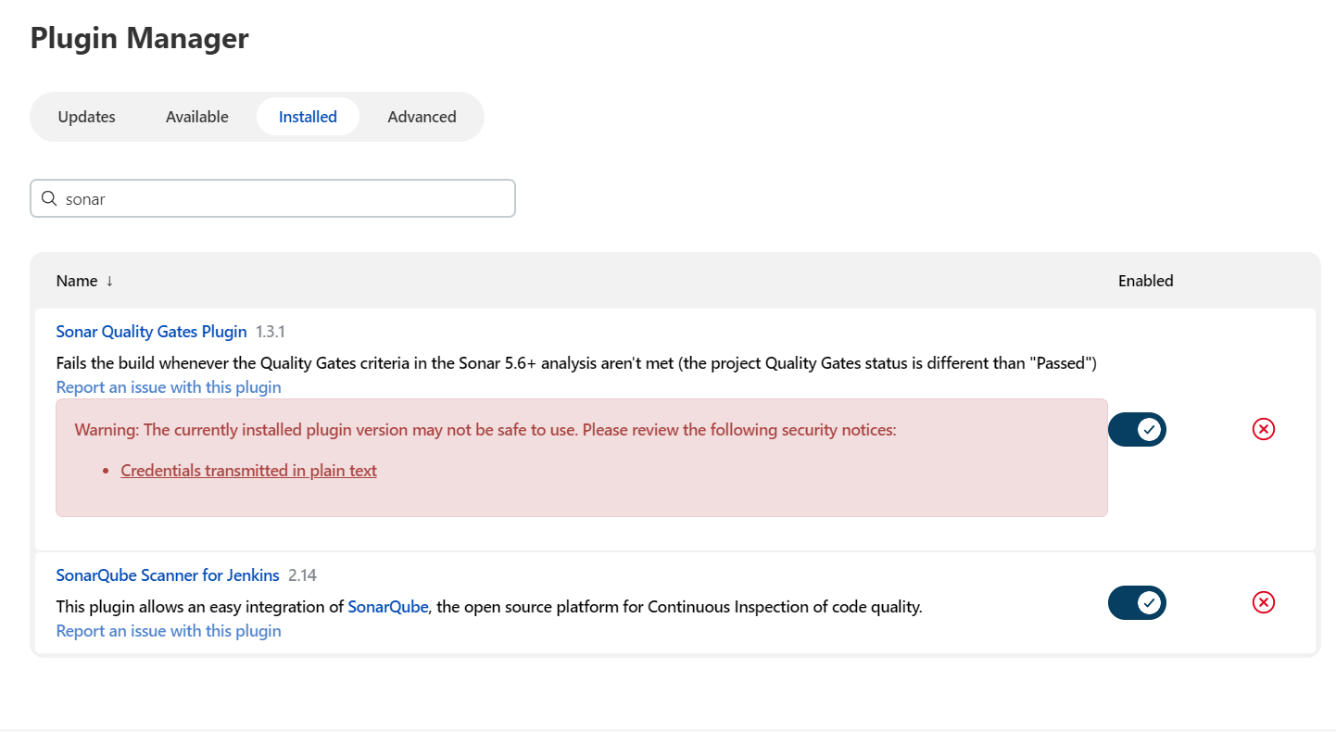
Install the following plugins for integrating with sonarqube
Sonar quality gates plugin.
Sonarqube scanner for Jenkins.

Slide 27
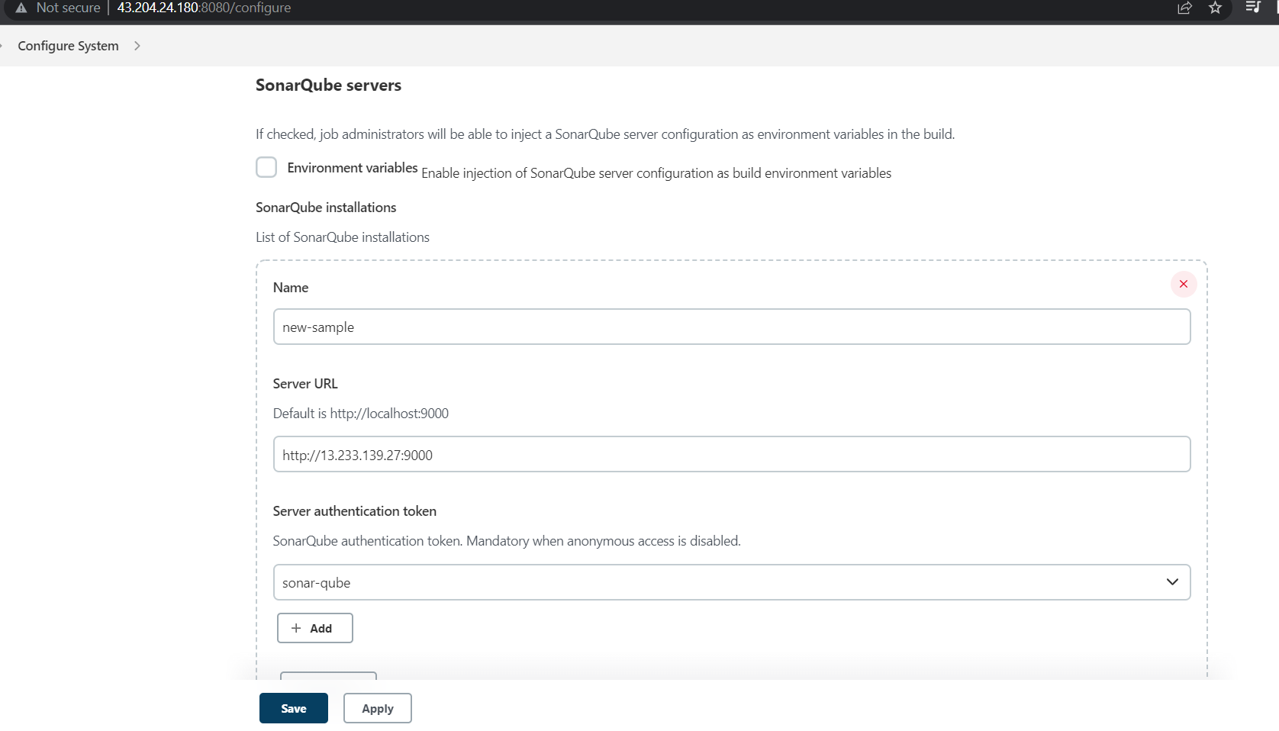
Open the configure system & provide the IP & server authentication token.

Slide 28
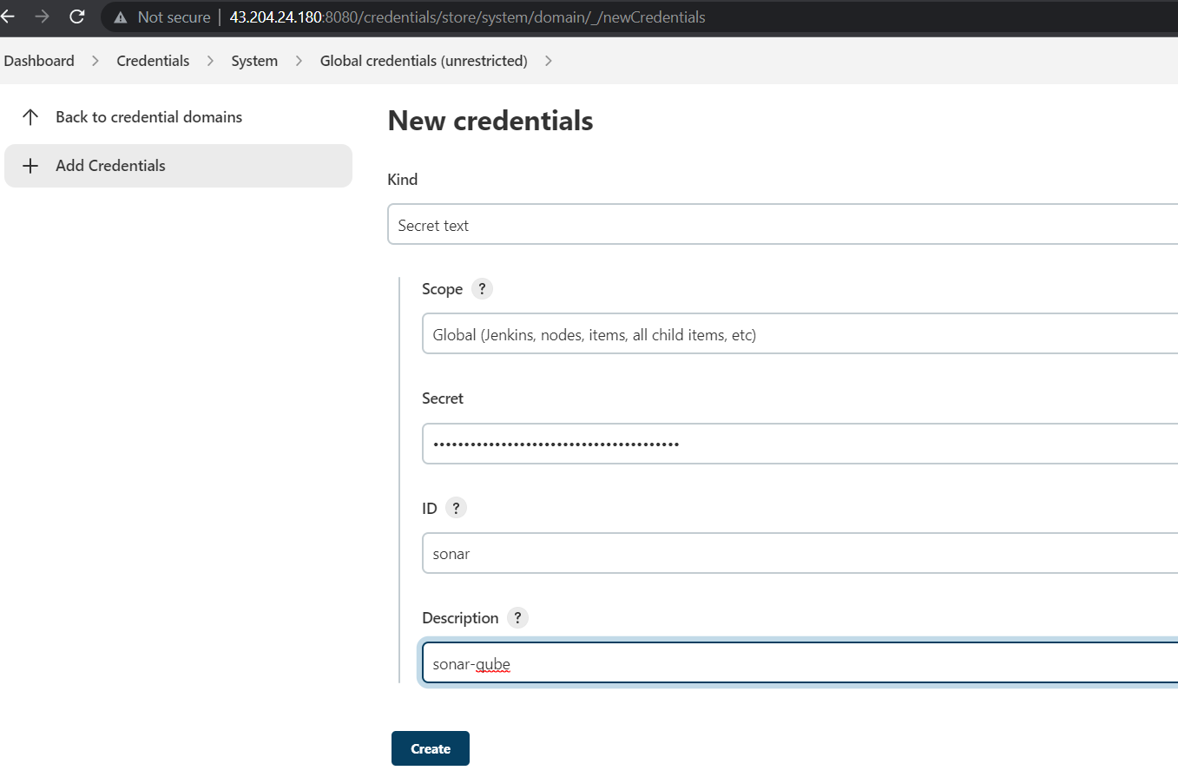
open the credentials & click on system, global credentials
Add the
sonarqube token.

Slide 29
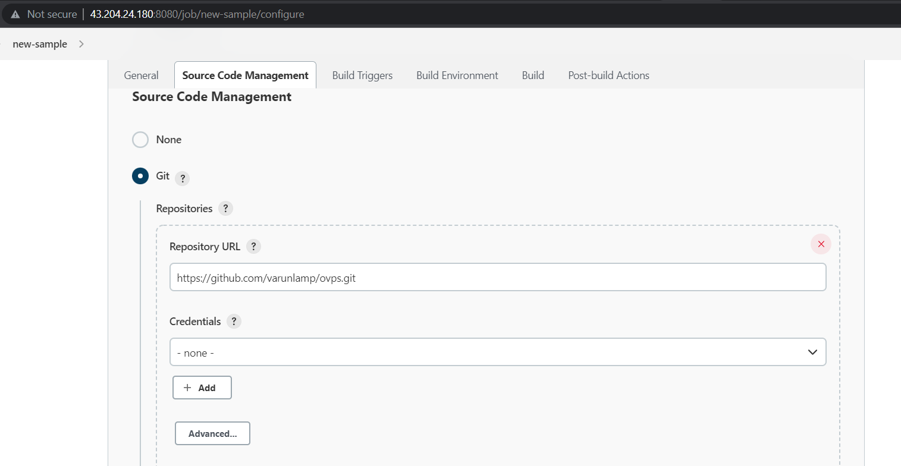
Provide the github repository url which consist of code.

Slide 30
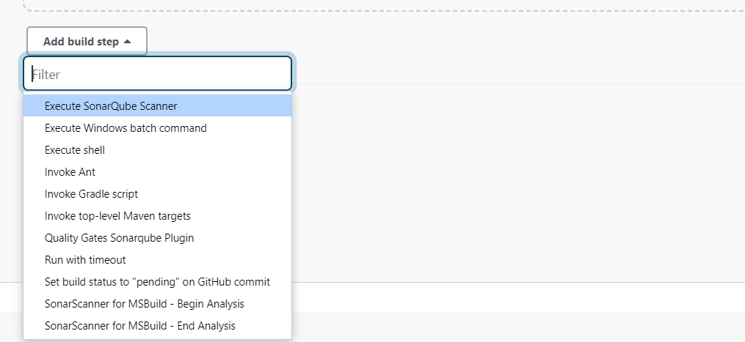
Click on add build step & select the
Execute sonarqube scanner.

Slide 31
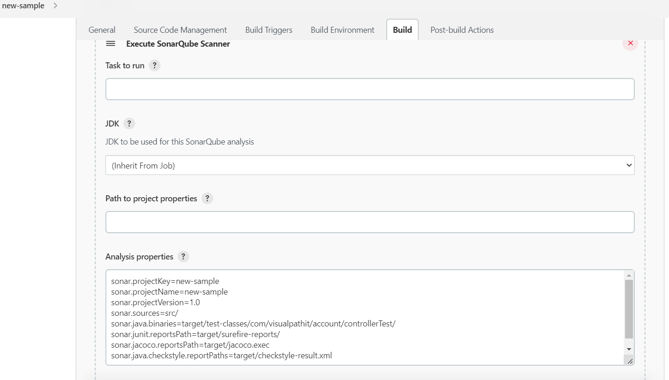
Add the properties which and all properties should be check in analysis properties.

Slide 32
Properties which need to be check in analysis properties.
sonar.projectKey=new-sample
sonar.projectName=new-sample
sonar.projectVersion=1.0
sonar.sources=src/
sonar.java.binaries=target/test-classes/com/visualpathit/account/controllerTest/
sonar.junit.reportsPath=target/surefire-reports/
sonar.jacoco.reportsPath=target/jacoco.exec
sonar.java.checkstyle.reportPaths=target/checkstyle-result.xml

Slide 33
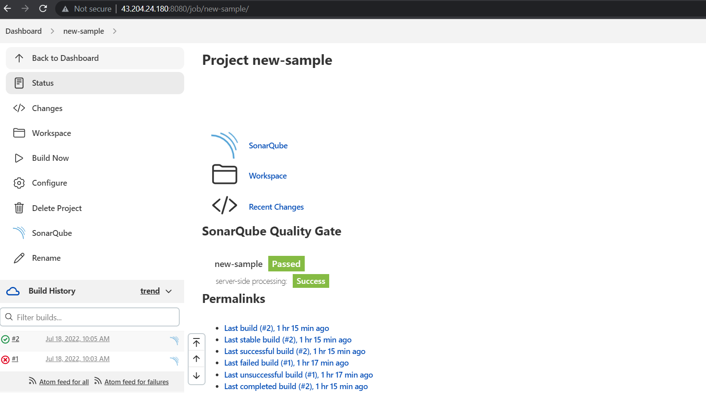
When we click on project it will display the report of bugs .

Slide 34
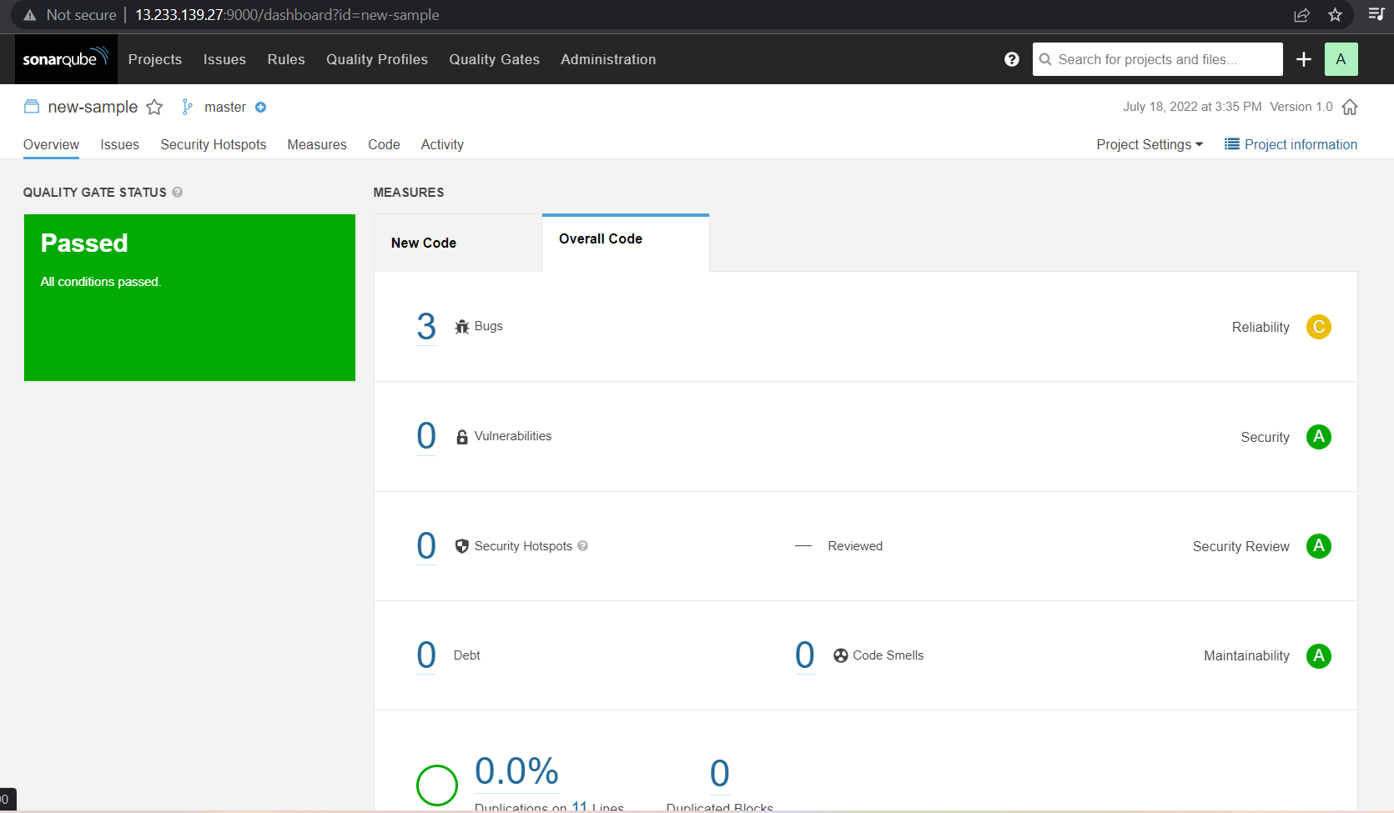
Generated report.

Slide 35
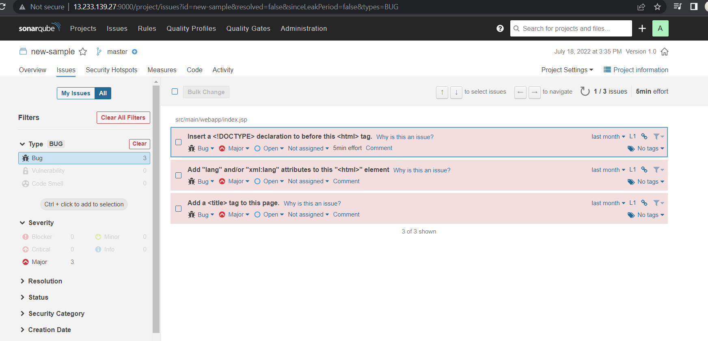
Bugs report/ it will display the errors & which needs to fix.

Slide 36
Thank you

